Slide 1















Standards
EL
LC
SD
GE
INSPIRE
Coverages
ER
OI
OF
SO
MF
LU
AC
NZ
EF
INSPIRE Coverages: Candidate Good Practice Webinar, 2021-02-26 Peter Baumann Jacobs University | rasdaman GmbH
Technically supported by:
Germany

Slide 2



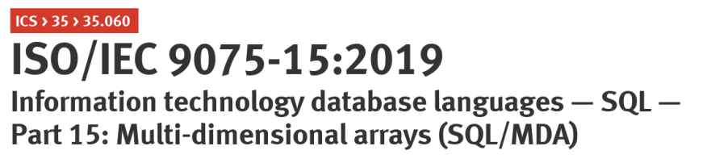
Coverage Standards & Friends
Geo:
Open Geospatial Consortium (OGC):
Coverage data model: Coverage Implementation Schema (CIS)
Coverage service model: Web Coverage Service (WCS) suite
ISO:
OGC CIS  19123-2
19123 revised  19123-1
INSPIRE:
OGC Coverages + INSPIRE Metadata
caveat:, incompatible: W3C Coverages, OGC EDR, CoverageJSON
General Data Analytics:
ISO: SQL/MDA („Multi-Dimensional Arrays“)
= rasdaman array QL
implemented by leading tools

Slide 3

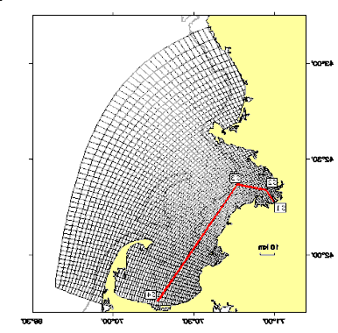
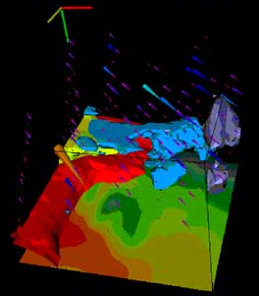
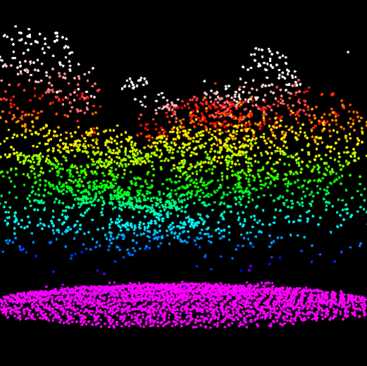
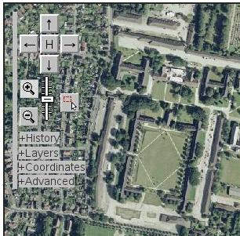
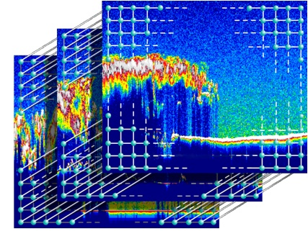
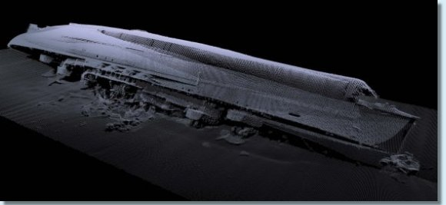
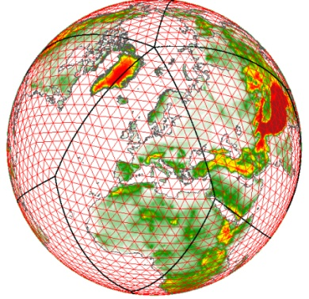
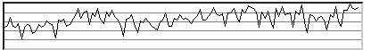
Coverages= Grids, Point Clouds, Meshes
abstract: OGC Abstract Topic 6 = ISO 19123
Concrete, interoperable: Coverage Implementation Schema (CIS, aka GMLCOV)
«FeatureType»
„datacubes“
Abstract Coverage
CIS 1.1 General Grid Coverage
MultiSolid Coverage
Grid Coverage
MultiSurface Coverage
Rectified GridCoverage
MultiCurve Coverage
Referenceable GridCoverage
MultiPoint Coverage

Slide 4

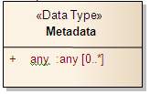
Coverage Definition
«Feature Type»
GML::Feature
INSPIRE!
«Feature Type»
Coverage
0..1 metadata
domainSet
rangeType
rangeSet
«Data Type»
«Data Type»
«Data Type»
DomainSet
SWE Common::DataRecord
RangeSet
[OGC 09-146r2]

Slide 5
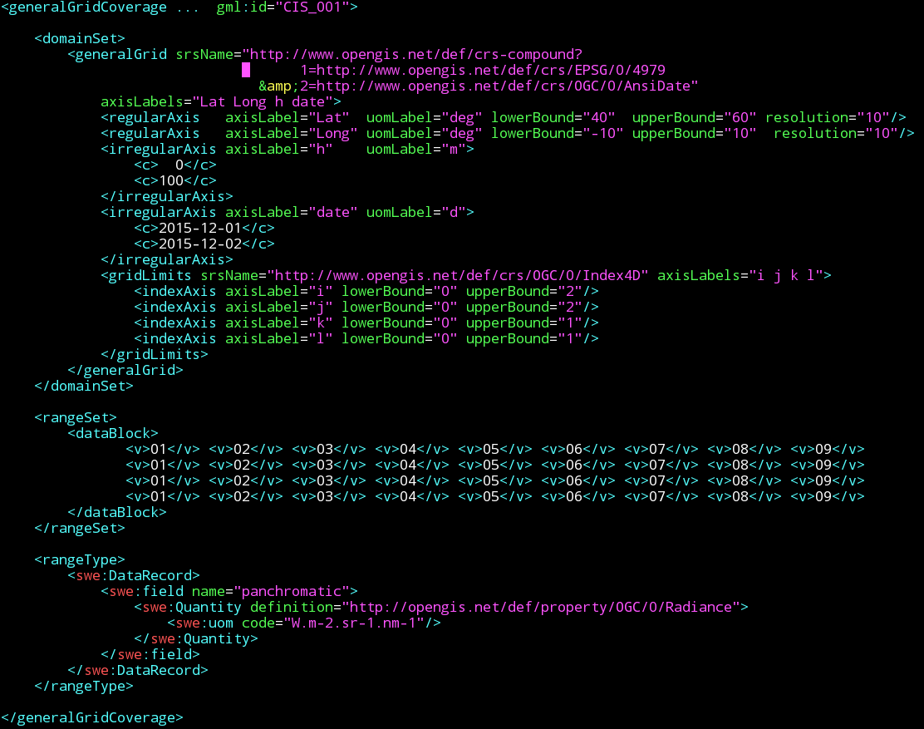
A Simple Coverage, in GML
examples on http://schemas.opengis.net/cis/1.1/

Slide 6
A Simple Coverage, in JSON
examples on http://schemas.opengis.net/cis/1.1/
{ "type": "CoverageByDomainAndRangeType", "domainSet":{ "type": "DomainSetType", "generalGrid":{ "type": "GeneralGridCoverageType", "srsName": "http://www.opengis.net/def/crs/OGC/0/Index2D", "axisLabels": ["i", "j"], "axis": [{ "type": "IndexAxisType“, "axisLabel": "i", "lowerBound": 0, "upperBound": 2 },{ "type": "IndexAxisType“, "axisLabel": "j", "lowerBound": 0, "upperBound": 2 }] } }, "rangeSet": { "type": "RangeSetType", "dataBlock": { "type": "VDataBlockType", "values": [1,2,3,4,5,6,7,8,9] } }, "rangeType": { "type": "DataRecordType", "field":[{ "type": "QuantityType", "definition": "ogcType:unsignedInt", "uom": { "type": "UnitReference", "code": "10^0“ } }] } }

Slide 7
A Simple Coverage, in RDF
examples on http://schemas.opengis.net/cis/1.1/
<http://www.opengis.net/cis/1.1/examples/CIS_05_2D> <http://www.w3.org/1999/02/22-rdf-syntax-ns#type> <http://www.opengis.net/cis/1.1/CoverageByDomainAndRangeType> .
<http://www.opengis.net/cis/1.1/examples/CIS_05_2D> <http://www.opengis.net/cis/1.1/domainSet> <http://www.opengis.net/cis/1.1/examples/CIS_DS_05_2D> .
<http://www.opengis.net/cis/1.1/examples/CIS_DS_05_2D> <http://www.opengis.net/cis/1.1/generalGrid> <http://www.opengis.net/cis/1.1/examples/CIS_DS_GG_05_2D> .
<http://www.opengis.net/cis/1.1/examples/CIS_DS_05_2D> <http://www.w3.org/1999/02/22-rdf-syntax-ns#type> <http://www.opengis.net/cis/1.1/DomainSetType> .
<http://www.opengis.net/cis/1.1/examples/CIS_DS_GG_05_2D> <http://www.opengis.net/cis/1.1/axis> <http://www.opengis.net/cis/1.1/examples/CIS_DS_GG_I_05_2D> .
<http://www.opengis.net/cis/1.1/examples/CIS_DS_GG_05_2D> <http://www.opengis.net/cis/1.1/axis> <http://www.opengis.net/cis/1.1/examples/CIS_DS_GG_J_05_2D> .
<http://www.opengis.net/cis/1.1/examples/CIS_DS_GG_05_2D> <http://www.opengis.net/cis/1.1/axisLabels> <http://www.opengis.net/cis/1.1/axisLabels0> .
<http://www.opengis.net/cis/1.1/axisLabels0> <http://www.w3.org/1999/02/22-rdf-syntax-ns#first> "i" .
<http://www.opengis.net/cis/1.1/axisLabels0> <http://www.w3.org/1999/02/22-rdf-syntax-ns#rest> <http://www.opengis.net/cis/1.1/axisLabels1> .
<http://www.opengis.net/cis/1.1/axisLabels1> <http://www.w3.org/1999/02/22-rdf-syntax-ns#first> "j" .
<http://www.opengis.net/cis/1.1/axisLabels1> <http://www.w3.org/1999/02/22-rdf-syntax-ns#rest> <http://www.w3.org/1999/02/22-rdf-syntax-ns#nil> .
<http://www.opengis.net/cis/1.1/examples/CIS_DS_GG_05_2D> <http://www.opengis.net/cis/1.1/srsName> <http://www.opengis.net/def/crs/OGC/0/Index2D> .
<http://www.opengis.net/cis/1.1/examples/CIS_DS_GG_05_2D> <http://www.w3.org/1999/02/22-rdf-syntax-ns#type> <http://www.opengis.net/cis/1.1/GeneralGridCoverageType> .
<http://www.opengis.net/cis/1.1/examples/CIS_DS_GG_I_05_2D> <http://www.opengis.net/cis/1.1/axisLabel> "i" .
<http://www.opengis.net/cis/1.1/examples/CIS_DS_GG_I_05_2D> <http://www.opengis.net/cis/1.1/lowerBound> "0"^^<http://www.w3.org/2001/XMLSchema#integer> .
<http://www.opengis.net/cis/1.1/examples/CIS_DS_GG_I_05_2D> <http://www.opengis.net/cis/1.1/upperBound> "2"^^<http://www.w3.org/2001/XMLSchema#integer> .
<http://www.opengis.net/cis/1.1/examples/CIS_DS_GG_I_05_2D> <http://www.w3.org/1999/02/22-rdf-syntax-ns#type> <http://www.opengis.net/cis/1.1/IndexAxisType> .
<http://www.opengis.net/cis/1.1/examples/CIS_DS_GG_J_05_2D> <http://www.opengis.net/cis/1.1/axisLabel> "j" .
<http://www.opengis.net/cis/1.1/examples/CIS_DS_GG_J_05_2D> <http://www.opengis.net/cis/1.1/lowerBound> "0"^^<http://www.w3.org/2001/XMLSchema#integer> .
<http://www.opengis.net/cis/1.1/examples/CIS_DS_GG_J_05_2D> <http://www.opengis.net/cis/1.1/upperBound> "2"^^<http://www.w3.org/2001/XMLSchema#integer> .
<http://www.opengis.net/cis/1.1/examples/CIS_DS_GG_J_05_2D> <http://www.w3.org/1999/02/22-rdf-syntax-ns#type> <http://www.opengis.net/cis/1.1/IndexAxisType> .
<http://www.opengis.net/cis/1.1/examples/CIS_05_2D> <http://www.opengis.net/cis/1.1/rangeSet> <http://www.opengis.net/cis/1.1/examples/CIS_RS_05_2D> .
<http://www.opengis.net/cis/1.1/examples/CIS_RS_05_2D> <http://www.w3.org/1999/02/22-rdf-syntax-ns#type> <http://www.opengis.net/cis/1.1/RangeSetRefType> .
<http://www.opengis.net/cis/1.1/examples/CIS_RS_DB_05_2D> <http://www.opengis.net/cis/1.1/fileReference> <http://myserver.com/fileref.tiff> .
<http://www.opengis.net/cis/1.1/examples/CIS_05_2D> <http://www.opengis.net/cis/1.1/rangeType> <http://www.opengis.net/cis/1.1/examples/CIS_RT_05_2D> .
<http://www.opengis.net/cis/1.1/examples/CIS_RT_05_2D> <http://www.opengis.net/swe/2.0/field> <http://www.opengis.net/cis/1.1/examples/CIS_RT_F_05_2D> .
<http://www.opengis.net/cis/1.1/examples/CIS_RT_05_2D> <http://www.w3.org/1999/02/22-rdf-syntax-ns#type> <http://www.opengis.net/swe/2.0/DataRecordType> .
<http://www.opengis.net/cis/1.1/examples/CIS_RT_F_05_2D> <http://www.opengis.net/swe/2.0/definition> <http://www.opengis.net/def/dataType/OGC/0/unsignedInt> .
<http://www.opengis.net/cis/1.1/examples/CIS_RT_F_05_2D> <http://www.opengis.net/swe/2.0/uom> <http://www.opengis.net/cis/1.1/examples/CIS_RT_F_UOM_05_2D> .
<http://www.opengis.net/cis/1.1/examples/CIS_RT_F_05_2D> <http://www.w3.org/1999/02/22-rdf-syntax-ns#type> <http://www.opengis.net/swe/2.0/QuantityType> .
<http://www.opengis.net/cis/1.1/examples/CIS_RT_F_UOM_05_2D> <http://www.opengis.net/swe/2.0/code> "10^0" .
<http://www.opengis.net/cis/1.1/examples/CIS_RT_F_UOM_05_2D> <http://www.w3.org/1999/02/22-rdf-syntax-ns#type> <http://www.opengis.net/swe/2.0/UnitReference> .

Slide 8
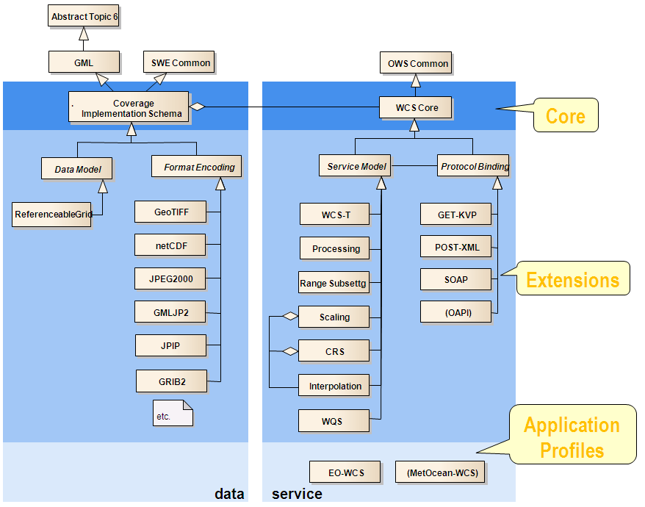
Encoding Coverages
OGC CIS:
GML, JSON, RDF, …
GeoTIFF, NetCDF, JPEG2000, GMLJP2, GRIB2, JPIP, …
Caveat: not GeoJSON, CoverageJSON

Slide 9
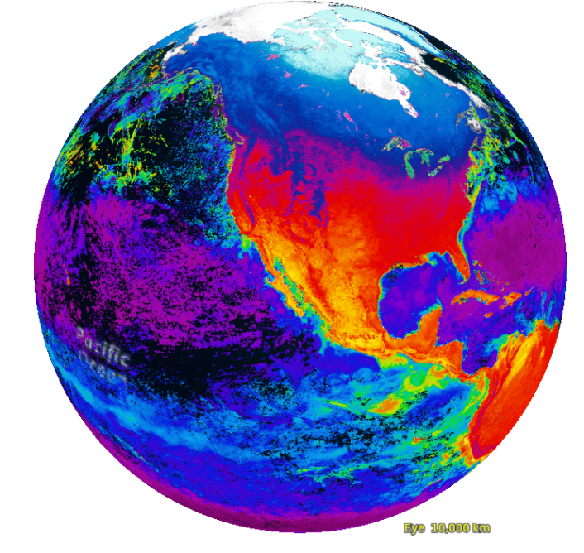


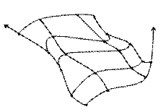
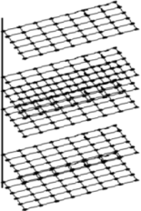
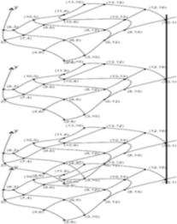
Summary
[AWI]
Coverage Implementation Schema (CIS)
regular & irregular grids
SWE-compliant range type definition
Working with O&M to enhance
Metadata for INSPIRE & any other information
Format-independent -- wide range of encodings
CIS = Accepted way to do coverages in ISO, OGC, INSPIRE
also adopted by ISO

Slide 10
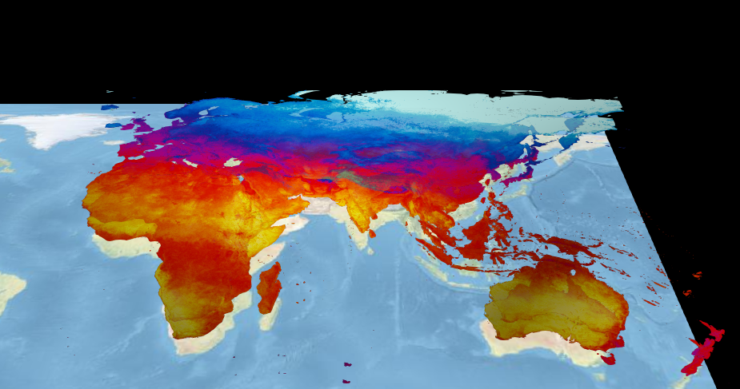
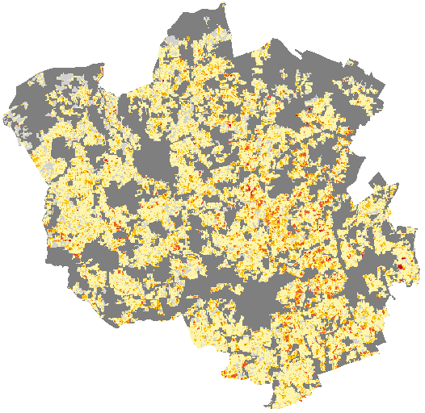
INSPIRE WCS = OGC WCS Core + OGC WCPS

Slide 11
OGC Web Coverage Service (WCS)
WCS Core: access to spatio-temporal coverages & subsets
Encoding on the fly
subset = trim | slice
WCS Extensions: optional functionality facets

Slide 12
WCS Core GetCoverage
Download a coverage (or a subset thereof), values guaranteed unchanged
Ex: „download coverage c001“
Ex: „coverage c001, lat/long cutout, time slice t=2009-11-06T23:20:52”
Ex: “coverage c001, in GeoTIFF”
http://www.acme.com/wcs ? SERVICE=WCS & VERSION=2.0 & REQUEST=GetCoverage & COVERAGEID=c001
http://www.acme.com/wcs ? SERVICE=WCS & VERSION=2.0 & REQUEST=GetCoverage & COVERAGEID=c001 & SUBSET=Long(100,120) & SUBSET=Lat(50,60) & SUBSET=time("2009-11-06T23:20:52")
http://www.acme.com/wcs ? SERVICE=WCS & VERSION=2.0 & REQUEST=GetCoverage & COVERAGEID=c001 & FORMAT=“image/tiff“

Slide 13
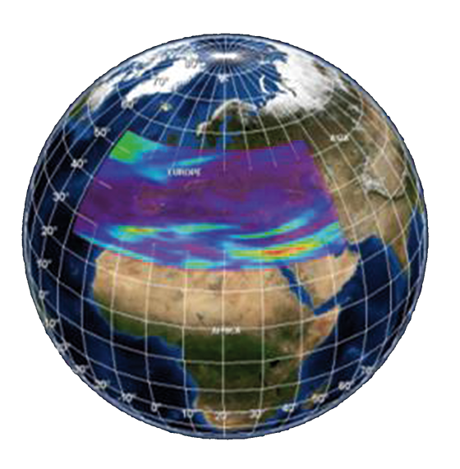

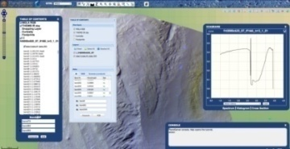
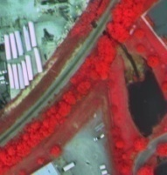
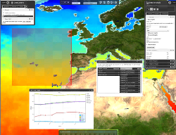
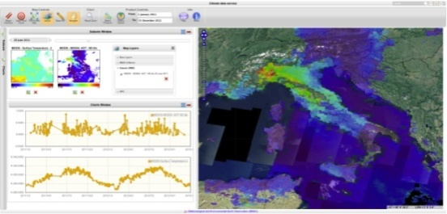
OGC Web Coverage Processing Service (WCPS)
spatio-temporal datacube analytics language
extraction, download, aggregation, analytics, fusion, …
Swiss army knife for raster services
"From MODIS scenes M1, M2, M3: difference red & nir, as TIFF"
“…but only those where nir exceeds 127 somewhere”
for $c in ( M1, M2, M3 ) where some( $c.nir > 127 ) return encode( $c.red - $c.nir, “image/tiff“ )

Slide 14
INSPIRE vs OGC
INSPIRE WCS = OGC WCS + OGC WCPS
INSPIRE Coverages = OGC CIS
INSPIRE metadata: via OGC CIS extensibility mechanism
INSPIRE WCS
OGC WCS
X
INSPIRE Coverages
≠
OGC CIS

Slide 15
Finally: Conformance Testing
Remember: INSPIRE Coverages = OGC CIS + INSPIRE metadata
OGC WCS conformance test  data
INSPIRE WCS conformance test  metadata
...implementations must pass both

Slide 16
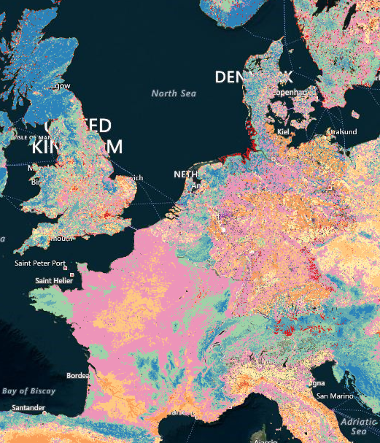
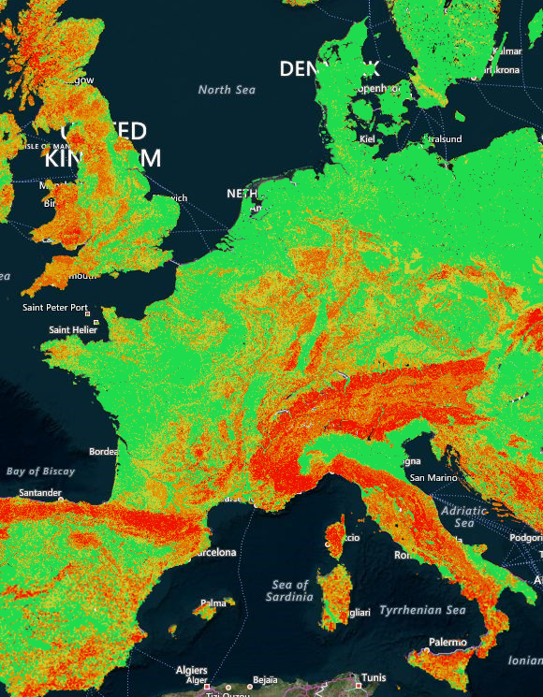
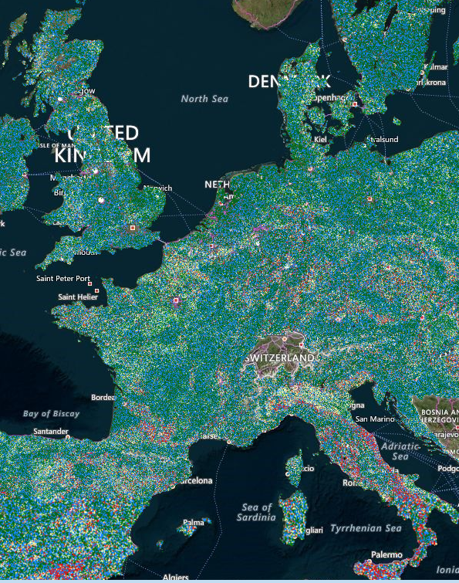
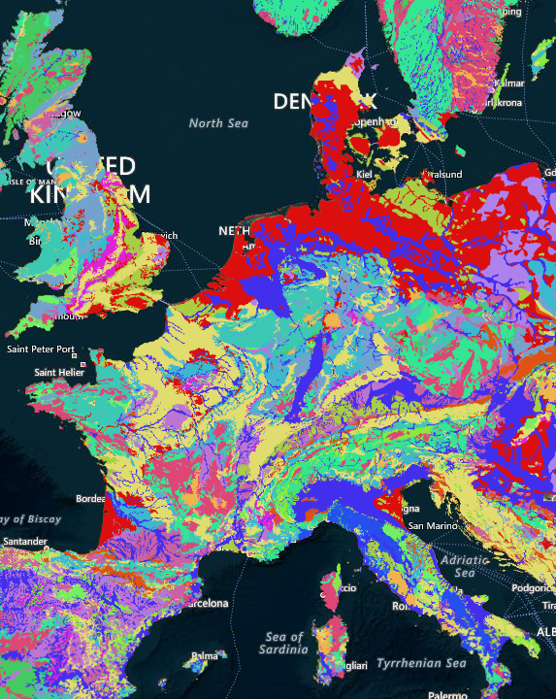
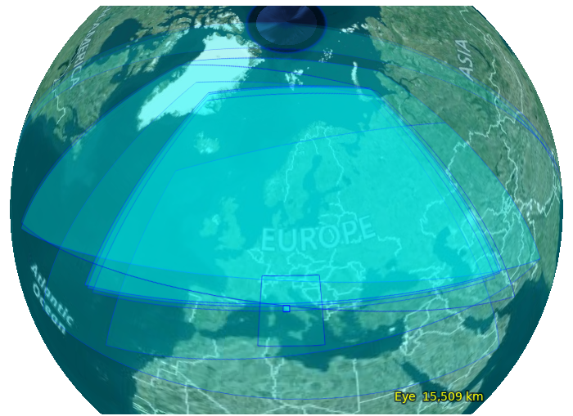
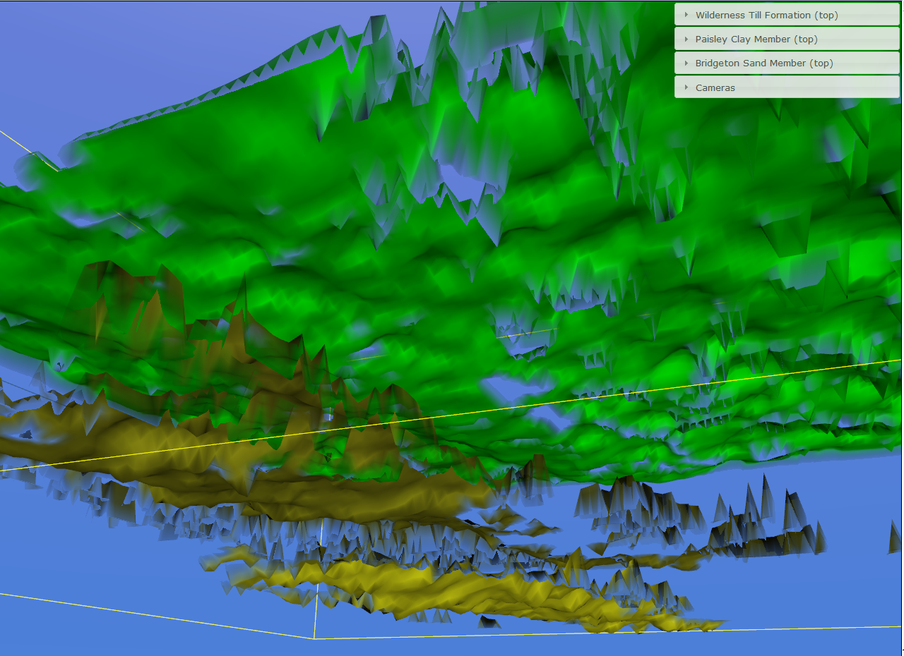
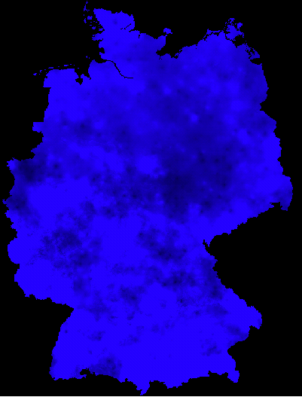
Summary
"WCS standard is mature & Implementations are diverse and well supported." – Alexander Kotsev, JRC
"Web developers who have not heard of OGC standards before immediately feel at home with these coverage standards" -- Stephan Siemen, ECMWF
INSPIRE Coverages = CIS + INSPIRE metadata, INSPIRE WCS = WCS + WCPS
robust, scalable, mature: multi-PB operational services
Monolithic vector + raster server? -- „no one size fits all“ [M. Stonebraker, MIT]
OGC standards designed for best-of-breed tool combination
load of educational material on earthserver.eu/wcs

Slide 17
BACKUP

Slide 18
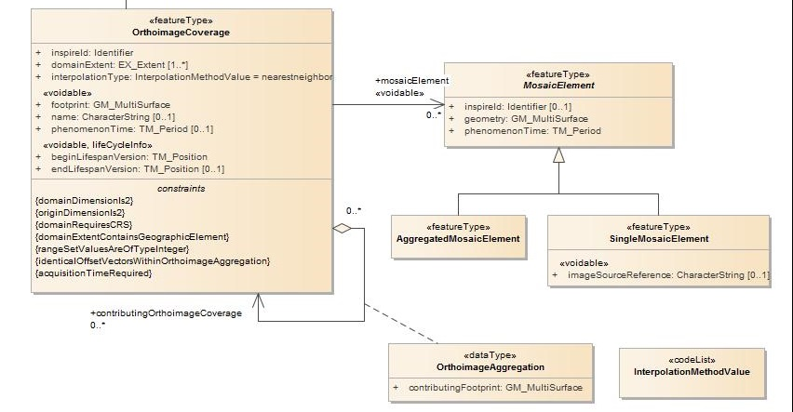
Coverages in INSPIRE, Ex: OI
x

Slide 19
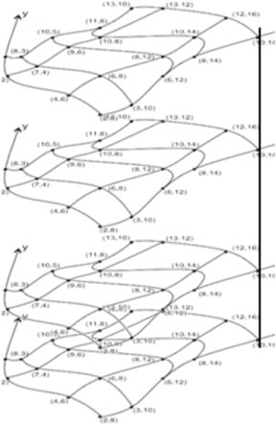
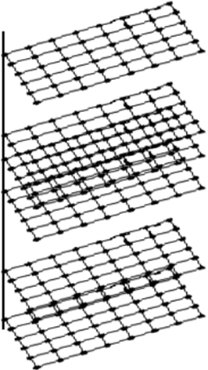
CIS: Grid Types  Axis Types
Observation: grid types (Rectified, Referenceable) non-intuitive, hard to describe, special cases only
CIS approach: axis types
Index axis: not georeferenced, IndexCRS
Regular axis: georeferenced, constant spacing
Irregular axis: georeferenced, variable spacing
Displacement axis nest: georeferenced, arbitrary grid point locations
Algorithmic coordinates: such as sensor model
All combinations possible
3 req classes:
Regular: index, regular
Irregular: irregular, displacement
Algorithmic: SensorML, ...

Slide 20
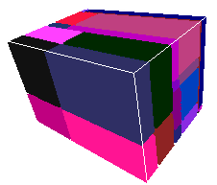
Encoding Coverages
Coverage
Domain set
Range type
Single file encoding:
Informationally complete: GML, JSON, RDF, …
Further formats: GeoTIFF, NetCDF, JPEG2000, GRIB, …
Range set
App Metadata
Multipart: container( “header” + file1 + file2 + … )
Multipart/MIME, zip, GMLJP2, SAFE, GeoPackage, ...
Built-in collections / tiling
Coverage
Coverage
Domain set
Domain set
Range type
Range type
xlink
xlink
App Metadata
App Metadata
NetCDF
NetCDF

Slide 21
CIS: Managing Complexity
Separate conformance classes for core, gridded and non-gridded data, partitioning, encoding
json-coverage
«depends-on»
json-ld-coverage
coverage-partitioning
coverage
gml-coverage
multipart-coverage
«depends-on»
«depends-on»
«depends-on»
«depends-on»
«depends-on»
other-format-coverage
grid-regular
discrete-pointcloud
«depends-on»
«depends-on»
grid-irregular
«depends-on»
discrete-mesh
grid-transformation

Slide 22
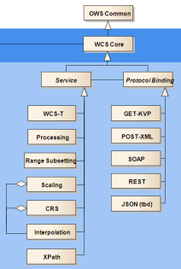
WCS Range Subsetting Extension
Extract range components
„bands“, „variables“
Request:
or:
or:
or:
or:
http://www.acme.com/wcs ? SERVICE=WCS & VERSION=2.0 & REQUEST=GetCoverage & COVERAGEID=c001 & RANGESUBSET=red
…& RANGESUBSET=nir,red,green &…
…& RANGESUBSET=green,red,blue &…
…& RANGESUBSET=nir:green &…
…& RANGESUBSET=band01,band03:band05,band19:band21 &…

Slide 23
WCS CRS Extension
Express coordinates in CRSs different from Native CRS
Result coverage
Subsetting coordinates
Request:
CRS definitions as URLs  OGC resolver
EPSG + many more CRSs
http://www.acme.com/wcs ? SERVICE=WCS & VERSION=2.0 & REQUEST=GetCoverage & COVERAGEID=c001 & SUBSETTINGCRS=http://www.opengis.net/def/crs/EPSG/0/4326 & OUTPUTCRS=http://www.opengis.net/def/crs/EPSG/0/4326

Slide 24
WCS Transaction Extension
= WCS-T: Modify coverage offerings on a server via Web
New requests: InsertCoverage + DeleteCoverage + UpdateCoverage (partial replacement)
Core design goal: GetCoverage  InsertCoverage
Ex:
http://www.acme.com/wcs ? SERVICE=WCS & VERSION = 2.0 & REQUEST=InsertCoverage & COVERAGEREF=http://bcme.com/archive/hurricane.nc

Slide 25
OGC WCS Suite: Big Picture

Slide 26
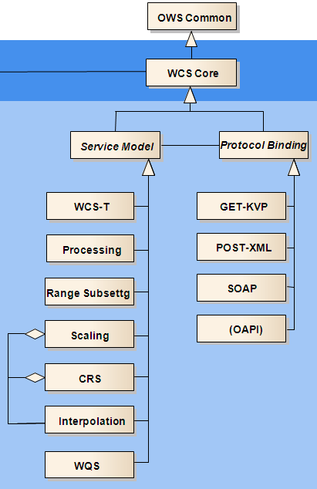
OAPI - Coverages
OAPI-Coverages: „all in URL“
based on CIS 1.1
Demo: https://oapi.rasdaman.com/rasdaman/oapi
Ex: https://oapi.rasdaman.org/rasdaman/oapi/collections/S2_NDVI_84/coverage? subset=Lat(51.9:52.1),Long(-4.1:-3.9),ansi(%222018-11-14%22)&f=image/png
Work in progress (estimate: ready no earlier than 2022)
Functionality currently subset of WCS
Main goal: simple servers
„some users might prefer something else than OAPI“ [Carl Reed, OGC]

